Slide 1

MetroGuard AI
MULTI-EVENT INCIDENT INTELLIGENCE FRAMEWORK FOR SMART METRO SURVEILLANCE
ADD415 PROJECT PHASE I
FINAL REVIEW
Presented By,
ADITHYA CHANDRAN – SPT23AD006
AKHIL P – SPT23AD009
MUHAMMED SHIBIL KP – SPT23AD034
SHEHRUZ MUHAMMED CS – SPT23AD043
Guided By :
Ms. ARYA N S
ASSISTANT PROFESSOR
Dept. of AD
On 16/10/2026

Slide 2
CONTENTS
• Introduction
• Problem Identification
• Motivation
• Objective
• Scope and significance
• Literature Review (20 papers)
• Block diagram
• Methodology / Results & Screenshots
• Work Plan
• Gannt Chart
• Resource Identification
• Task allocation
• Conclusion
• References
16/10/2026
AI & DS DEPARTMENT, SIMAT
2

Slide 3
INTRODUCTION
Metro rail systems rely on CCTV for passenger safety and daily operations monitoring.
Existing AI systems detect isolated events independently.
They generate multiple unrelated alerts.
They require manual interpretation by operators.
The framework integrates multiple computer vision techniques into one decision-support system.
16/10/2026
AI & DS DEPARTMENT, SIMAT
3

Slide 4
PROBLEM IDENTIFICATION
• Current AI surveillance systems detect events independently.
• Security personnel must manually correlate scattered alerts.
• Lack of contextual understanding makes incident severity difficult to estimate.
• Repeated, unprioritized alerts lead to alert fatigue.
• A context-aware framework is required to assess risk and prioritize responses.
16/10/2026
AI & DS DEPARTMENT, SIMAT
4

Slide 5
MOTIVATION
Current AI surveillance systems detect events independently, generating multiple isolated alerts for related incidents.
Manual correlation of scattered alerts increases operator workload and response time.
Lack of contextual understanding makes incident severity difficult to assess.
Repeated, unprioritized alerts can lead to alert fatigue and reduced operator efficiency.
A context-aware framework is needed to correlate events, assess risk, and prioritize responses in real time.
16/10/2026
AI & DS DEPARTMENT, SIMAT
5

Slide 6
OBJECTIVE
Integrate YOLO object detection, ByteTrack multi-object tracking and activity recognition.
Correlate related events.
Estimate incident severity and prioritize incidents.
Generate explainable incident reports.
Assist metro operators in decision making.
16/10/2026
AI & DS DEPARTMENT, SIMAT
6

Slide 7
SCOPE AND SIGNIFICANCE
• Metro Stations, Railway Stations, Airports and Bus Terminals.
• Improves passenger safety.
• Reduces operator workload.
• Faster emergency response.
• Supports Smart City surveillance.
16/10/2026
AI & DS DEPARTMENT, SIMAT
7

Slide 8
LITERATURE REVIEW
No.
Paper Title
Key Features Introduced
Relevance to Project
1
ABDviaMSIFAT: Abnormal Crowd Behavior Detection Utilizing a Multi-Source Information Fusion Technique [1]
• Dual visual and motion feature extraction
• Weighted multi-source score fusion
• Provides a basis for multi-source incident fusion
• Supports contextual event correlation
2
Intelligent Anomaly Detection and Localization With Crowd Density Estimation for Improved Public Safety [2]
• Crowd-density estimation
• Anomaly localization heatmaps
• Crowd density can be a risk input
• Supports the crowd module
3
Abandoned Object Detection and Classification Using Deep Embedded Vision [3]
• Deep embedded vision
• Background and feature classification
• Supports object classification
• Provides scene-adaptive background cues
4
Abnormal Activity Detection and Classification of Bus Passengers With In-Vehicle Image Sensing [4]
• Abnormal passenger activity detection
• Fighting, falling and suspicious actions
• Relevant to public-transport safety
• Supports event-category selection
5
Towards Surveillance Video-and-Language Understanding: New Dataset, Baselines, and Challenges [5]
• Surveillance video-language dataset
• Event descriptions and baselines
• Supports explainable incident summaries
• Improves operator alert clarity
16/10/2026
AI & DS DEPARTMENT, SIMAT
8

Slide 9
LITERATURE REVIEW
No.
Paper Title
Key Features Introduced
Relevance to Project
6
A Two-Stage Spatiotemporal CNN-YOLOv9 Framework for High-Precision Real-Time Abandoned Object Detection in Public Surveillance Videos [6]
• Two-stage CNN-YOLOv9 approach
• Spatio-temporal ownership analysis
• Supports detect-then-analyse design
• Handles crowded and occluded scenes
7
A Multi Object Tracking Framework Based on YOLOv8s and ByteTrack Algorithm [7]
• YOLO detection with ByteTrack
• Persistent identities across frames
• Directly supports our tracking backbone
• Enables temporal event analysis
8
Leveraging Fusion Methods of Human Pose and Motion Dynamics for Accurate Violence Detection in Video Surveillance [8]
• Human-pose and motion fusion
• Skeleton and optical-flow features
• Supports fight-detection features
• Can complement object detection
9
Context-aware Video Anomaly Detection in Long-Term Datasets [9]
• Long-term temporal context
• Context-based anomaly classification
• Shows the value of scene context
• Helps reduce isolated alerts
10
Spatio-Temporal Semantic Algorithm for Video Anomaly Detection from Monitoring Perspectives [10]
• Spatial, temporal and semantic features
• Monitoring-oriented anomaly analysis
• Supports scene-level understanding
• Motivates multi-context reasoning
16/10/2026
AI & DS DEPARTMENT, SIMAT
9

Slide 10
LITERATURE REVIEW
No.
Paper Title
Key Features Introduced
Relevance to Project
11
Graph-Based Knowledge Driven Approach for Violence Detection [11]
• Spatial-temporal knowledge graphs
• Graph-based violence reasoning
• Supports context fusion
• Helps higher-level incident reasoning
12
Action Knowledge Graph for Violence Detection Using Audiovisual Features [12]
• Knowledge graph for violence context
• Audiovisual feature fusion
• Supports relationship-aware reasoning
• Helps describe violent incidents
13
Real-Time Video Surveillance Analysis at the Edge in Smart Cities [13]
• Edge AI for real-time video
• Detection, tracking and event correlation
• Supports low-latency deployment
• Fits CCTV-based metro systems
14
VD-Net: An Edge Vision-Based Surveillance System for Violence Detection [14]
• Lightweight edge violence detection
• Low-compute real-time design
• Supports near-real-time fight detection
• Fits edge deployment needs
15
An Attention-Based Unsupervised Framework for Video Anomaly Detection in Large Heterogeneous Environments [15]
• Attention-based anomaly regions
• Unsupervised learning for CCTV
• Helps handle diverse camera views
• Reduces label requirements
16/10/2026
AI & DS DEPARTMENT, SIMAT
10

Slide 11
LITERATURE REVIEW
No.
Paper Title
Key Features Introduced
Relevance to Project
16
Real-Time Human Group Detection and Clustering in Crowded Environments Using Enhanced Multi-Object Tracking [16]
• Enhanced multi-object tracking
• Proximity and trajectory clustering
• Adds group-level context
• Complements ByteTrack tracking
17
Multi-Scale Video Anomaly Detection by Multi-Grained Spatio-Temporal Representation Learning [17]
• Multi-scale spatio-temporal features
• Local and global anomaly learning
• Useful for people, crowds and objects
• Supports multi-level event analysis
18
CFTformer: End-to-End Cross-Frame Multi-Object Tracking With Transformer [18]
• Cross-frame transformer tracking
• Trajectory refinement and attention
• Suggests a future tracking upgrade
• Helps reduce identity switches
19
SCL-YOLOv11: A Lightweight Object Detection Network for Low-Illumination Environments [19]
• Lightweight YOLOv11 for low light
• Image enhancement and distillation
• Supports poorly lit metro scenes
• Improves robust object detection
20
Online Action Detection by Long Short-Term Transformer with Query Exemplars [20]
• Long Short-Term Transformer
• Online temporal action detection
• Supports streaming event analysis
• Useful for fight localization
16/10/2026
AI & DS DEPARTMENT, SIMAT
11

Slide 12
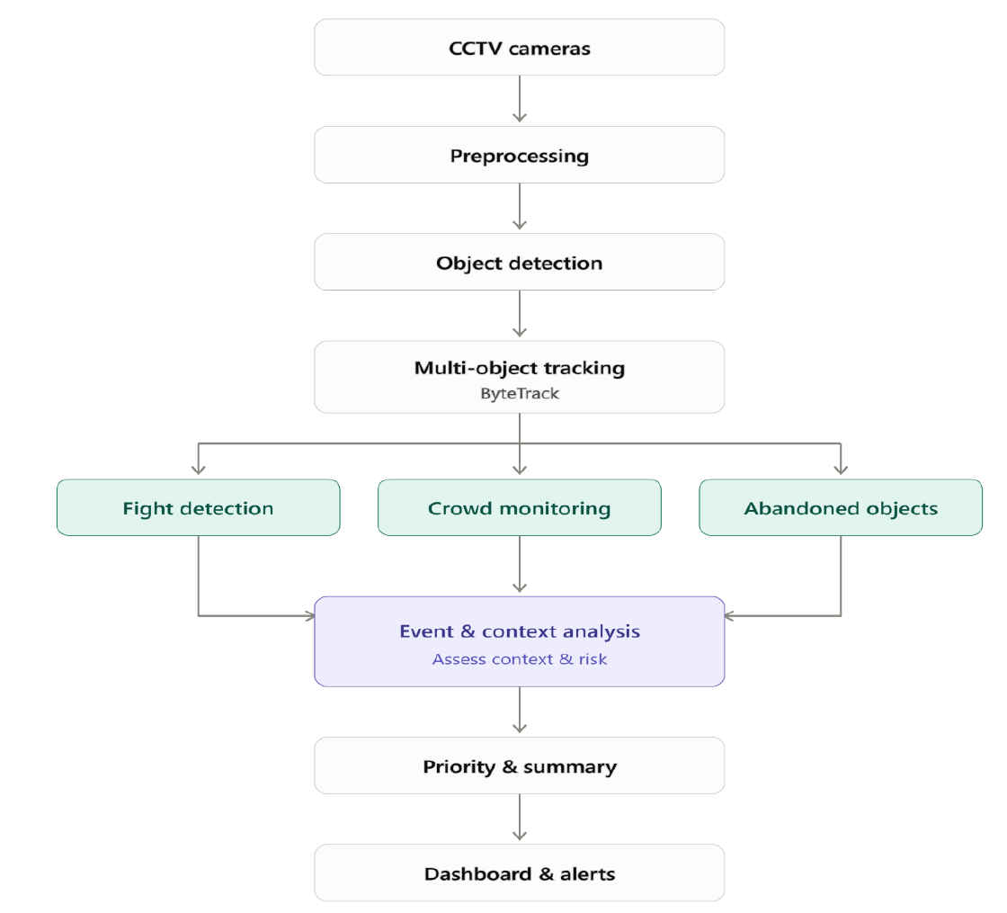
BLOCK DIAGRAM
16/10/2026
AI & DS DEPARTMENT, SIMAT
12

Slide 13
METHODOLOGY
• CCTV feeds are processed through preprocessing.
• YOLOv11 detects people and objects in each frame.
• ByteTrack follows detected entities across frames.
• Fight, crowd and abandoned-object modules run in parallel.
• Event and context analysis assesses context and risk.
• The system generates priority level and incident summary.
• Results are pushed to an interactive dashboard for real-time alerts.
16/10/2026
AI & DS DEPARTMENT, SIMAT
13

Slide 14
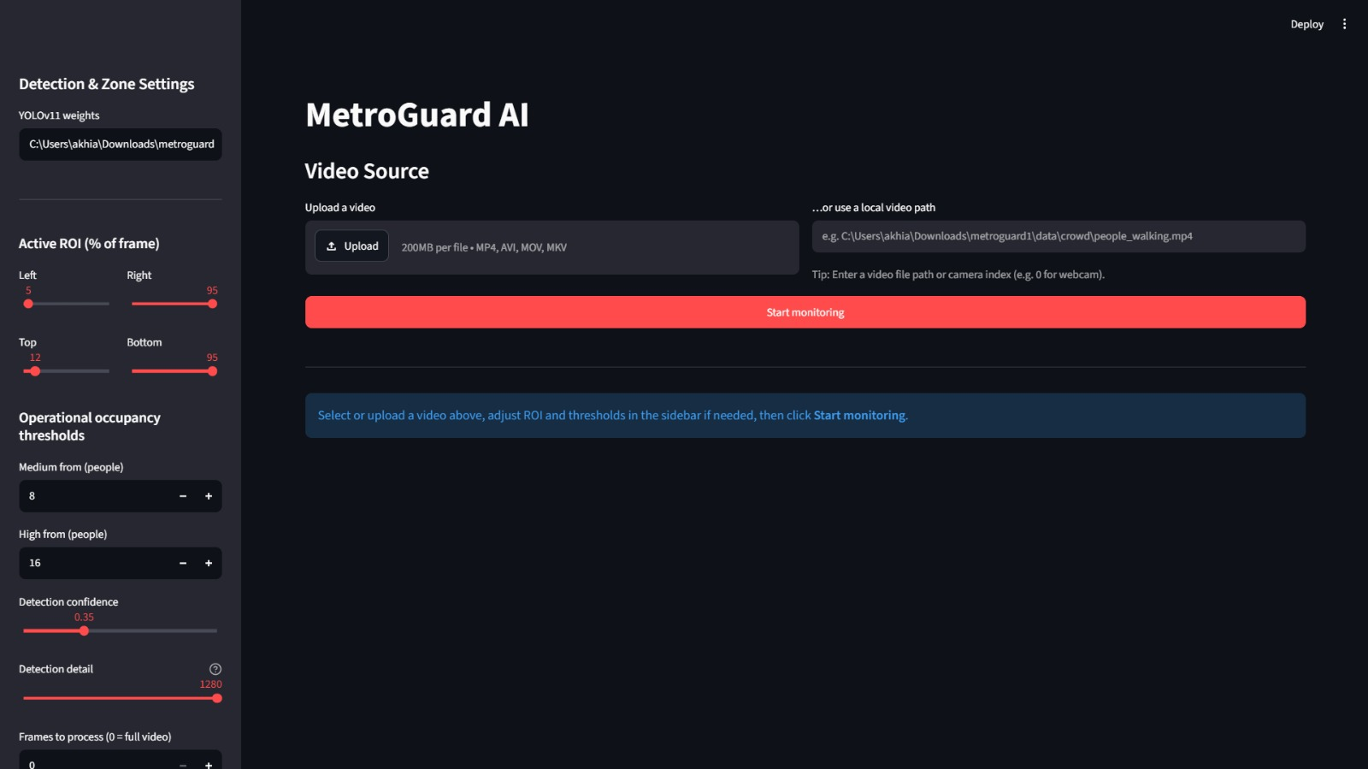
DASHBOARD – VIDEO INPUT
Phase-I operator dashboard: video selection, region settings and occupancy thresholds
16/10/2026
AI & DS DEPARTMENT, SIMAT
14

Slide 15
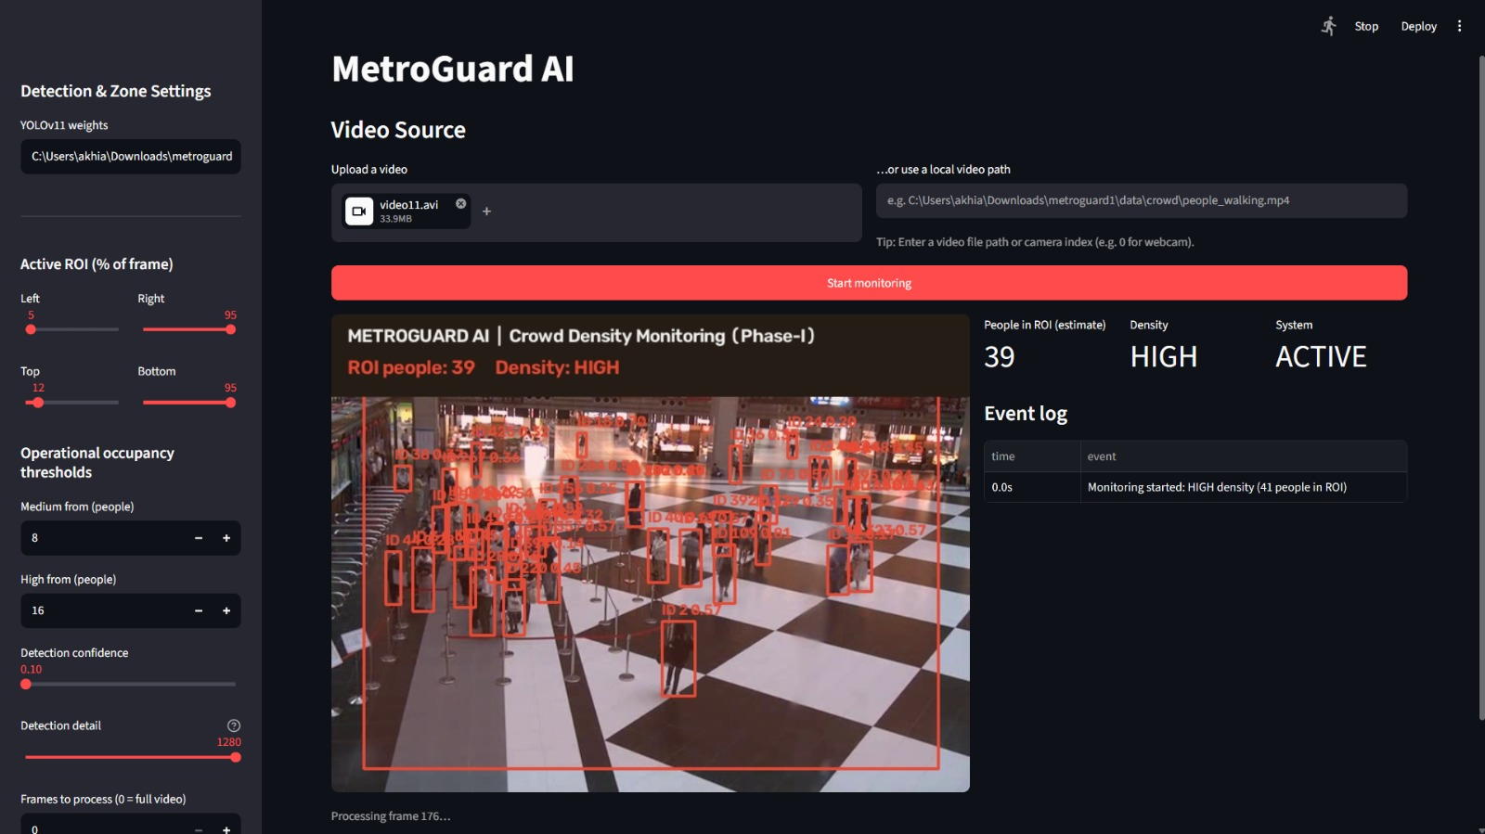
CROWD MONITORING – RESULT
Demonstration frame: 39 people in ROI, HIGH occupancy status, active event log
16/10/2026
AI & DS DEPARTMENT, SIMAT
15

Slide 16
WORK TILL DATE – PHASE I
• Video upload and local-path input through the Streamlit dashboard.
• YOLOv11s person detection with ByteTrack identity association.
• Selectable Region of Interest (ROI) and ground-contact person counting.
• LOW / MEDIUM / HIGH occupancy status with configurable thresholds.
• Live annotated video, people count and timestamped event log.
16/10/2026
AI & DS DEPARTMENT, SIMAT
16

Slide 17
TECHNOLOGIES & IMPLEMENTATION
• YOLOv11s: detects commuters in each CCTV video frame.
• ByteTrack: maintains tracking IDs across successive frames.
• OpenCV: decodes video and draws zones, boxes and annotations.
• Streamlit: provides operator controls, live indicators and event logs.
• ROI footpoint filtering: counts people standing within the selected zone.
16/10/2026
AI & DS DEPARTMENT, SIMAT
17

Slide 18
TAM – TARGET TRACKING MODULE
• YOLOv11s and ByteTrack identify and follow a selected person.
• MobileSAM uses a tracked box as a prompt for silhouette segmentation.
• Target telemetry includes dwell time, trajectory and ROI position.
• This is distinct from the crowd-density demonstration shown earlier.
16/10/2026
AI & DS DEPARTMENT, SIMAT
18

Slide 19
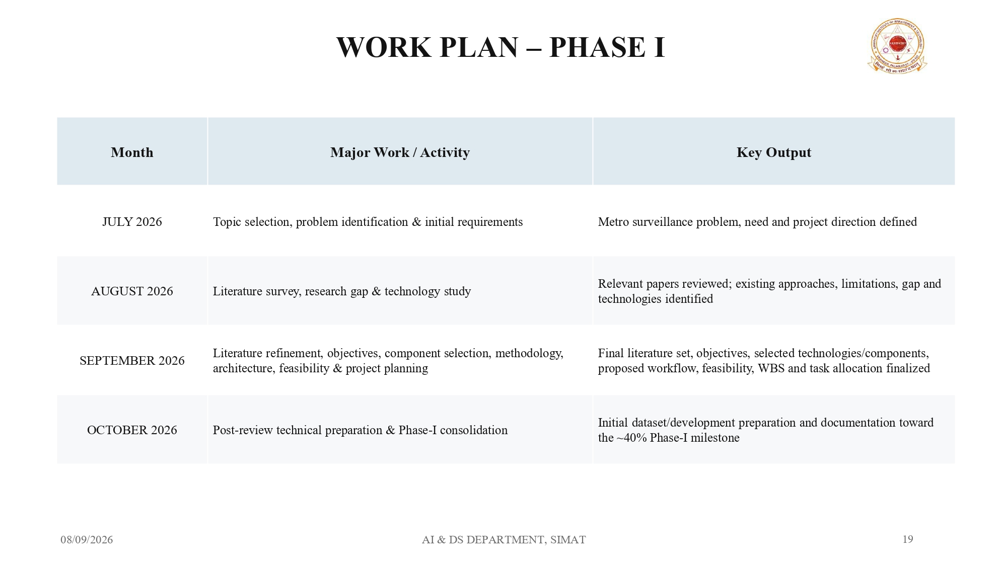
WORK PLAN
Phase | Major Tasks
1 | Literature study and requirements
2 | Dataset preparation
3 | Detection and tracking modules
4 | Incident reasoning and risk assessment
5 | Dashboard and system integration
6 | Testing, evaluation and documentation
16/10/2026
AI & DS DEPARTMENT, SIMAT
19

Slide 20
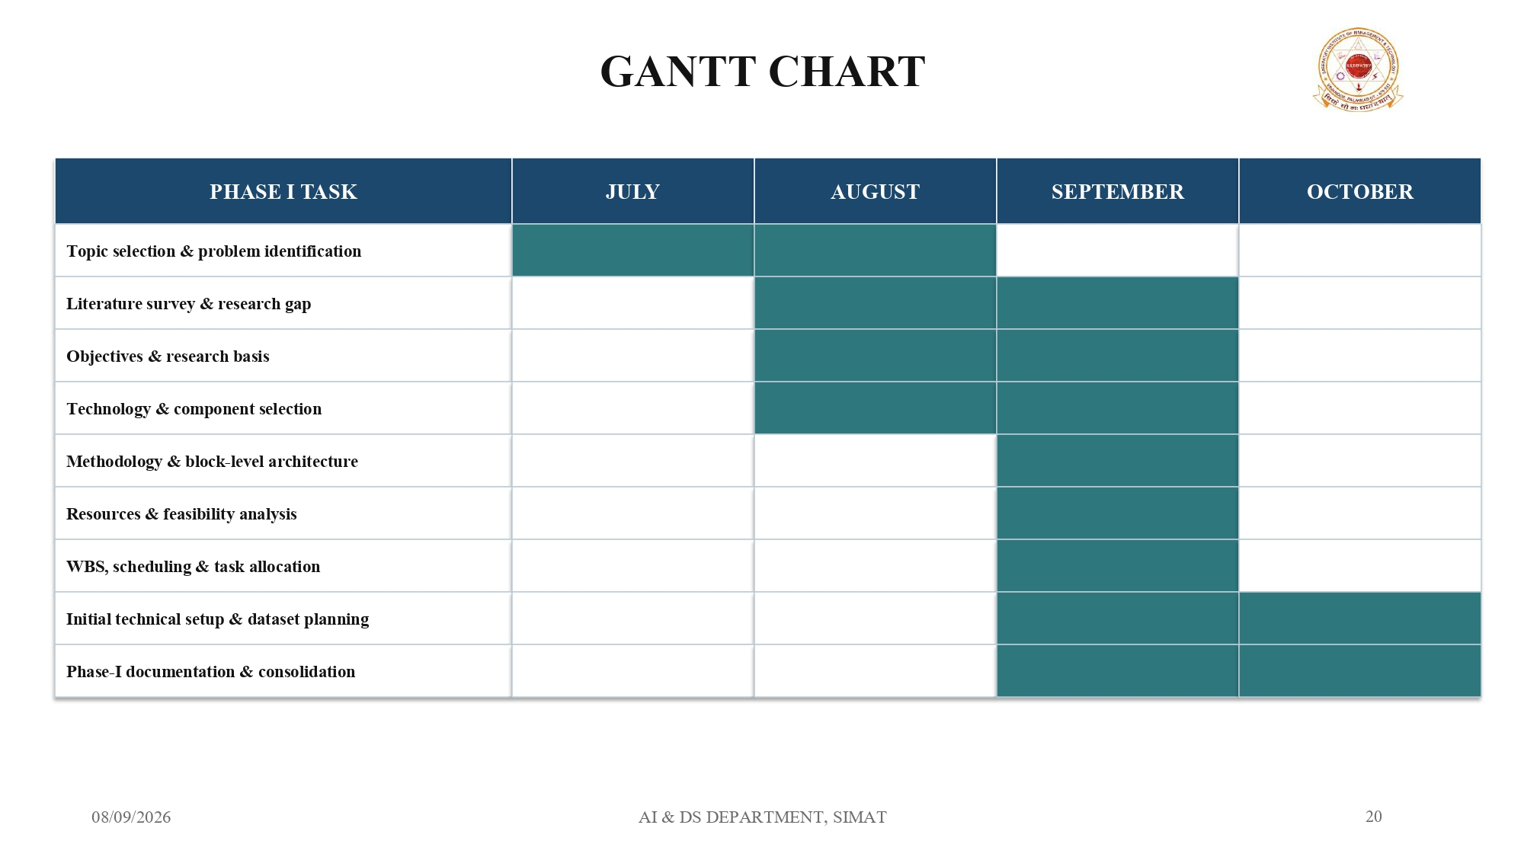
GANNT CHART
JUL
AUG
SEP
OCT
Literature & requirements
Dataset preparation
Detection modules
Tracking & event extraction
Incident reasoning & risk
Dashboard & integration
Testing & evaluation
Report & final presentation
16/10/2026
AI & DS DEPARTMENT, SIMAT
20

Slide 21
RESOURCE IDENTIFICATION
• Development PC / GPU system
• CCTV or recorded video source
• Storage for datasets and video clips
• Python and deep-learning libraries
• Ultralytics YOLOv11 and ByteTrack
• OpenCV and dashboard tools
• Public surveillance datasets
16/10/2026
AI & DS DEPARTMENT, SIMAT
21

Slide 22
TASK ALLOCATION
ADITHYA CHANDRAN : System architecture, YOLOv11 integration and dashboard.
AKHIL P : Dataset preparation, abandoned-object module and model training.
MUHAMMED SHIBIL KP : Literature review, ByteTrack/tracking and fight-detection module.
SHEHRUZ MUHAMMED CS : Incident reasoning, context fusion, risk assessment and report.
ALL MEMBERS : Testing, documentation and final presentation preparation.
16/10/2026
AI & DS DEPARTMENT, SIMAT
22

Slide 23
CONCLUSION
• The framework unifies multi-event detection, tracking and risk assessment.
• It detects multiple event types from CCTV.
• It prioritizes incidents using risk assessment.
• It supports faster and smarter security response.
• It is scalable for future smart transportation systems.
16/10/2026
AI & DS DEPARTMENT, SIMAT
23

Slide 24
REFERENCES
[1] A. A. Hamid, S. A. Monadjemi, and B. Shoushtarian, “ABDviaMSIFAT: Abnormal Crowd Behavior Detection Utilizing a Multi-Source Information Fusion Technique,” IEEE Access, vol. 13, pp. 75000–75019, 2025, doi: 10.1109/ACCESS.2024.3436007
.
[2] D. Chaudhary, S. Kumar, and V. S. Dhaka, “Intelligent Anomaly Detection and Localization With Crowd Density Estimation for Improved Public Safety,” IEEE Access, vol. 13, pp. 169912–169928, 2025, doi: 10.1109/ACCESS.2025.3614146.
[3] A. M. Qasim, N. Abbas, A. Ali, and B. A. A. Al-Ghamdi, “Abandoned Object Detection and Classification Using Deep Embedded Vision,” IEEE Access, vol. 12, pp. 35539–35551, 2024, doi: 10.1109/ACCESS.2024.3369233.
[4] H.-Y. Lin and C.-H. Tseng, “Abnormal Activity Detection and Classification of Bus Passengers With In-Vehicle Image Sensing,” IEEE Access, 2024, doi: 10.1109/ACCESS.2024.3365138.
[5] T. Yuan, X. Zhang, K. Liu, B. Liu, C. Chen, J. Jin, and Z. Jiao, “Towards Surveillance Video-and-Language Understanding: New Dataset, Baselines, and Challenges,” in Proc. IEEE/CVF CVPR, 2024, pp. 22052–22061, doi: 10.1109/CVPR52733.2024.02082.
[6] S. F. A. Shah, M. Q. Khan, A. A. Alsuwaylimi, and L. A. Alenezi, “A Two-Stage Spatiotemporal CNN-YOLOv9 Framework for High-Precision Real-Time Abandoned Object Detection in Public Surveillance Videos,” IEEE Access, vol. 14, pp. 35983–35997, 2026, doi: 10.1109/ACCESS.2026.3669588.
[7] Y. Wang and V. Y. Mariano, “A Multi Object Tracking Framework Based on YOLOv8s and ByteTrack Algorithm,” IEEE Access, 2024, doi: 10.1109/ACCESS.2024.3450370.
[8] S. T. Y. Aung, W. Kusakunniran, and Y. K. Hooi, “Leveraging Fusion Methods of Human Pose and Motion Dynamics for Accurate Violence Detection in Video Surveillance,” IEEE Access, 2025, doi: 10.1109/ACCESS.2025.3613765.
[9] Z. Yang and R. J. Radke, “Context-aware Video Anomaly Detection in Long-Term Datasets,” in Proc. IEEE/CVF CVPR Workshops, 2024, pp. 4002–4011, doi: 10.1109/CVPRW63382.2024.00404.
[10] Z. Zhu, H. He, and M. Wang, “A Spatio-Temporal Semantic Algorithm for Video Anomaly Detection from Monitoring Perspectives,” in Proc. 5th Int. Conf. Artificial Intelligence, Robotics, and Communication (ICAIRC), 2025, doi: 10.1109/ICAIRC68035.2025.11385035.
16/10/2026
AI & DS DEPARTMENT, SIMAT
24

Slide 25
[11] M. Khan, W. Gueaieb, A. Elsaddik, G. De Masi, and F. Karray, “Graph-Based Knowledge Driven Approach for Violence Detection,” IEEE Consumer Electronics Magazine, vol. 14, no. 1, pp. 77–85, 2025, doi: 10.1109/MCE.2024.3446192.
[12] M. Khan, M. Saad, A. Khan, W. Gueaieb, A. E. Saddik, G. De Masi, and F. Karray, “Action Knowledge Graph for Violence Detection Using Audiovisual Features,” in Proc. IEEE Int. Conf. Consumer Electronics (ICCE), 2024, doi: 10.1109/ICCE59016.2024.10444158.
[13] A. S. Kannan, Z. A. Alsalami, A. Nihlani, K. Gowthami, M. A. K. Abdukodir Kizi, A. Amudha, and Z. Mamadalieva, “Real-Time Video Surveillance Analysis at the Edge in Smart Cities,” in Proc. Int. Conf. Innovations and Emerging Technologies in AI & Communication Systems (IETACS), 2025, doi: 10.1109/IETACS68750.2025.11385417.
[14] M. Khan, A. E. Saddik, W. Gueaieb, G. De Masi, and F. Karray, “VD-Net: An Edge Vision-Based Surveillance System for Violence Detection,” IEEE Access, vol. 12, pp. 43796–43808, 2024, doi: 10.1109/ACCESS.2024.3380192.
[15] M. H. Habeb, M. Salama, and L. A. Elrefaei, “An Attention-Based Unsupervised Framework for Video Anomaly Detection in Large Heterogeneous Environments,” in Proc. MIUCC, 2024, doi: 10.1109/MIUCC62295.2024.10783549.
[16] H. Lee, D. Kang, H. Park, S. Park, D. Jeong, and J. Paik, “Real-Time Human Group Detection and Clustering in Crowded Environments Using Enhanced Multi-Object Tracking,” IEEE Access, vol. 12, pp. 184028–184039, 2024, doi: 10.1109/ACCESS.2024.3503661.
[17] M. Zhang, J. Wang, Q. Qi, H. Sun, Z. Zhuang, P. Ren, R. Ma, and J. Liao, “Multi-Scale Video Anomaly Detection by Multi-Grained Spatio-Temporal Representation Learning,” in Proc. IEEE/CVF CVPR, 2024, pp. 17385–17394, doi: 10.1109/CVPR52733.2024.01646.
[18] A. Amirkhani and S. A. Khoshnevis, “CFTformer: End-to-End Cross-Frame Multi-Object Tracking With Transformer,” IEEE Access, 2025, doi: 10.1109/ACCESS.2025.3567349.
[19] S. Zhuo, H. Bai, L. Jiang, X. Zhou, X. Duan, Y. Ma, and Z. Zhou, “SCL-YOLOv11: A Lightweight Object Detection Network for Low-Illumination Environments,” IEEE Access, vol. 13, pp. 47653–47662, 2025, doi: 10.1109/ACCESS.2025.3550947.
[20] H. Zhang, Y. Guo, and X. Du, “Online Action Detection by Long Short-Term Transformer with Query Exemplars,” in Proc. IEEE Int. Joint Conf. Neural Networks (IJCNN), 2024, doi: 10.1109/IJCNN60899.2024.10651333.
[21] T. Soontornnapar, “Abandoned Bag Detection in Public Areas Using Grounding DINO With Fine-Grained Prompts,” in Proc. ECTI-CON, 2025, doi: 10.1109/ECTI-CON64996.2025.11100886.
16/10/2026
AI & DS DEPARTMENT, SIMAT
25

Slide 26
THANK YOU

